Slide 1

Birkbeck OP R Training Day 1:
Making sense of data with R
17 March 2022
Thanks to RStudio Education for many of the slides!

Slide 2
Your Turn
Form groups of 2-3 people. Introduce yourself to your group members. Tell them:
Who you are
What you do with data
What you want to get from this training
How you would answer the warm-up question: Data analysis as a household task
05:00
Notes:
But the most important people you will be working with today are seated right beside you

Slide 3
HELLO
my name is
Lukas

Slide 4

Create maps, not proofs
Notes:
So how do we fix science? We have an easy model to follow. During the age of exploration, navigators attempted to discover and document unknown corners of the world. This is exactly what scientists do.
Think of Christopher Columbus as an example. When Columbus discovered the New World, he didn't return to Spain and justify his discovery with some type of logical test. Instead, he provided a map for other explorers to follow. If they followed the map and it led to where Columbus said it did, then the discovery spoke for itself. On the other hand, if they followed the map and it did not lead to where Columbus claimed, that too would speak for itself.
Like Columbus, good scientists create maps for others to follow, not proofs. We are looking for real things that will speak for themselves, so long as we show others how to find them.

Slide 5
(Experimental) Science
Reproducible workflow
Experiment
Data
Hypothesis
Conclusions
Notes:
In many ways, scientists have always known this. Scientists have a very robust culture for making maps that lead from hypotheses to data. Many scientific articles comprise just this type of map. This system worked very well when data was nearly synonymous with conclusion.
But in the age of data scientists, scientists must follow a chain of reasoning to get from the data to conclusions, and scientists do not provide good maps to lead others through this reasoning.
Part of the difficulty is the number of things that a useable map would need to include. The map would need to include the data collected, the code used to analyze the data, the software used to run the code, and the reasoning that guided the whole process and interpreted the results.

Slide 6
Data Analysis
Experiment
Data
Hypothesis
Conclusions
Notes:
In many ways, scientists have always known this. Scientists have a very robust culture for making maps that lead from hypotheses to data. Many scientific articles comprise just this type of map. This system worked very well when data was nearly synonymous with conclusion.
But in the age of data scientists, scientists must follow a chain of reasoning to get from the data to conclusions, and scientists do not provide good maps to lead others through this reasoning.
Part of the difficulty is the number of things that a useable map would need to include. The map would need to include the data collected, the code used to analyze the data, the software used to run the code, and the reasoning that guided the whole process and interpreted the results.

Slide 7
Data Analysis
Data
Data
Experiment
Visualize
Transform
Model
Hypothesis
Conclusions
Notes:
In many ways, scientists have always known this. Scientists have a very robust culture for making maps that lead from hypotheses to data. Many scientific articles comprise just this type of map. This system worked very well when data was nearly synonymous with conclusion.
But in the age of data scientists, scientists must follow a chain of reasoning to get from the data to conclusions, and scientists do not provide good maps to lead others through this reasoning.
Part of the difficulty is the number of things that a useable map would need to include. The map would need to include the data collected, the code used to analyze the data, the software used to run the code, and the reasoning that guided the whole process and interpreted the results.

Slide 8
Data Analysis
Import
Tidy
Data
Visualize
Transform
Experiment
Model
Hypothesis
Conclusions
Notes:
In many ways, scientists have always known this. Scientists have a very robust culture for making maps that lead from hypotheses to data. Many scientific articles comprise just this type of map. This system worked very well when data was nearly synonymous with conclusion.
But in the age of data scientists, scientists must follow a chain of reasoning to get from the data to conclusions, and scientists do not provide good maps to lead others through this reasoning.
Part of the difficulty is the number of things that a useable map would need to include. The map would need to include the data collected, the code used to analyze the data, the software used to run the code, and the reasoning that guided the whole process and interpreted the results.

Slide 9
Visualize
Import
Tidy
Model
Reason
Communicate
Transform
Program
Notes:
We'll start with visualizing data. I need everyone to be able to visualize their data with confidence. This will make it easier to understand what we're doing when we start transforming data later in the workshop.

Slide 10






(Rough) Agenda
10:00 – 10:45: Introduction
10:45 – 12:30: Visualize and transform data
12:30 – 13:15: Lunch
13:15 – 14:45: Summarise and model data
15:00 – 15:40: Import and tidy data
15:45 – 16:00: Q&A, feedback and closing

Slide 11
R and RStudio

Slide 12
Get the materials
Install git, fork and create new project from repository
Go to LINK, click green “Code” button, then download Zip and extract in folder

Slide 13

User friendly (?)
Widely used & growing
Designed for data science
(Designed to run other languages)
A language
13

Slide 14

A language
Writing software

Slide 15
R the language
Values: 1, "London", "2022-03-17"

Slide 16
R the language
Values: 1, "London", "2022-03-17"
Objects: my_result <- 22/7
A value, object, or function result
A name without quotes
< followed by -
(looks like an arrow)

Slide 17
R the language
Values: 1, "London", "2022-03-17"
Objects: some_nums <- c(22/7, .99, 3)
To put multiple values into an object, combine them with c() – a “vector”
A name without quotes, case-sensitive

Slide 18
R the language
Values: 1, "London", "2022-03-17"
Objects: some_nums <- c(22/7, .99, 3)
Functions: round(some_nums, digits = 1)
A name without quotes
followed by () to run the function
Arguments: values, objects, or function results (named or ordered)

Slide 19
Warm Up
Which of these are numbers?
1
"1"
"one"
one

Slide 20
Warm Up
Which of these are numbers?
1
"1"
"one"
one
number

Slide 21
Warm Up
Which of these are numbers?
1
"1"
"one"
one
number
words (strings)

Slide 22
Warm Up
Which of these are numbers?
1
"1"
"one"
one
number
words (strings)
object

Slide 23
Warm Up
Which of these will work? Suppose one <- 1
log(1)
log("1")
log("one")
log(one)

Slide 24
Warm Up
Which of these will work? Suppose one <- 1.
log(1)
log("1")
log("one")
log(one)

Slide 25
R Markdown
Notes:
Okay. That was the longest you will hear me lecture all day! From here out, you guys take the lead. Now you know all the pre-requisite minutiae to get started. Let's start writing some code.

Slide 26
Your Turn
Go to 01-Introduction.
Open 01-RMarkdown-Exercises.Rmd. Read through the file and do everything it tells you to do.
05:00

Slide 27
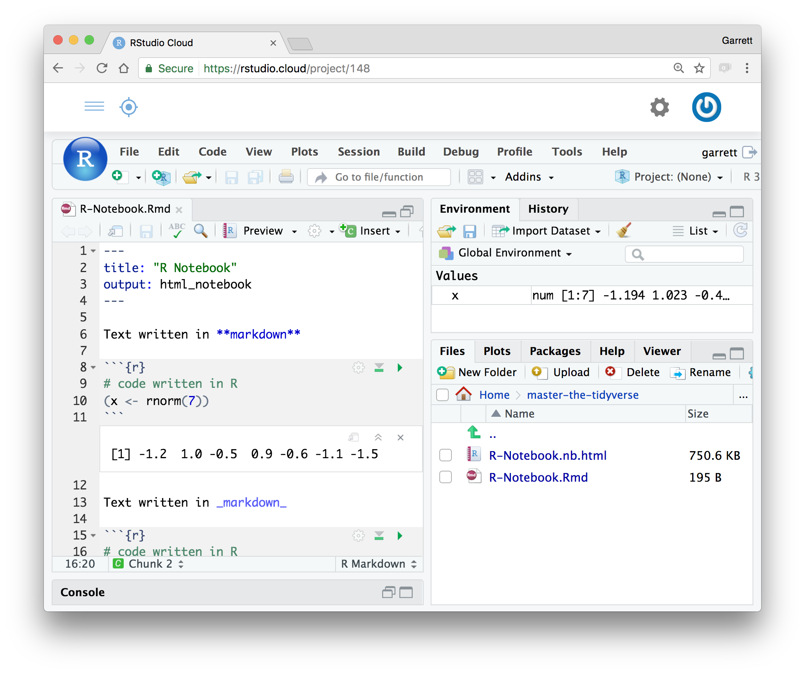
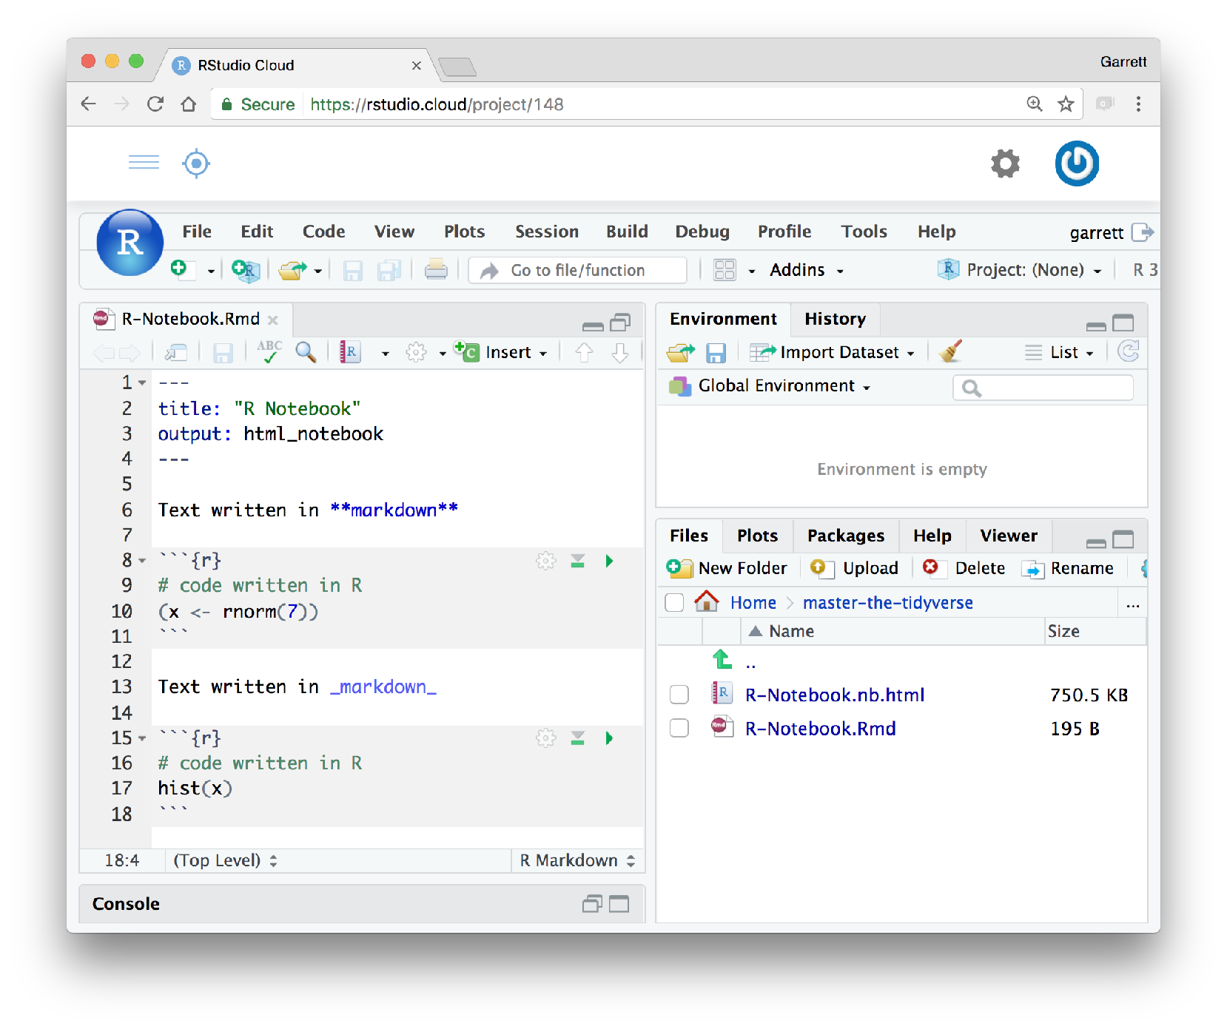
R Markdown
An authoring format for Data Science.
Code, output and interpretation in one place.
Code goes in a chunk
(```{r} to ```)
Click to run code in chunk
Code result
Click on .Rmd file to open notebook

Slide 28
R Packages
Notes:
Raise your hand if you know what an R package is (do or skip the next slide according to the results)

Slide 29
Your Turn
(If you know) explain to your group what an R package is and share an example of a package.
01:00

Slide 30
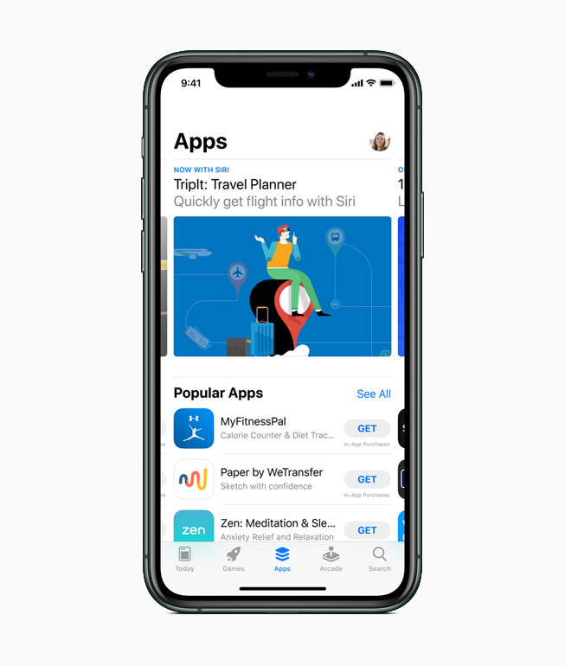
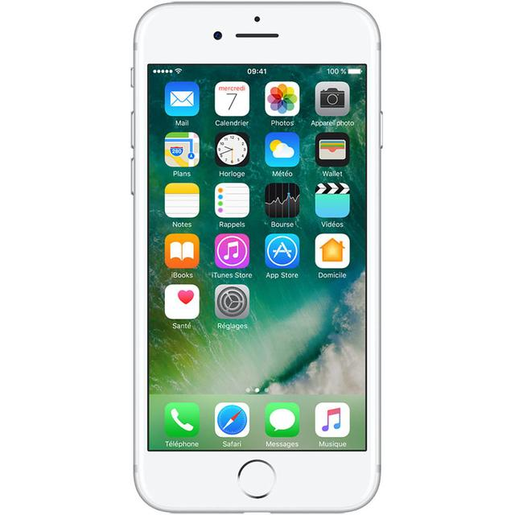
Base R and packages
“Operating system” and core functionalities
Extended functionality and alternatives

Slide 31
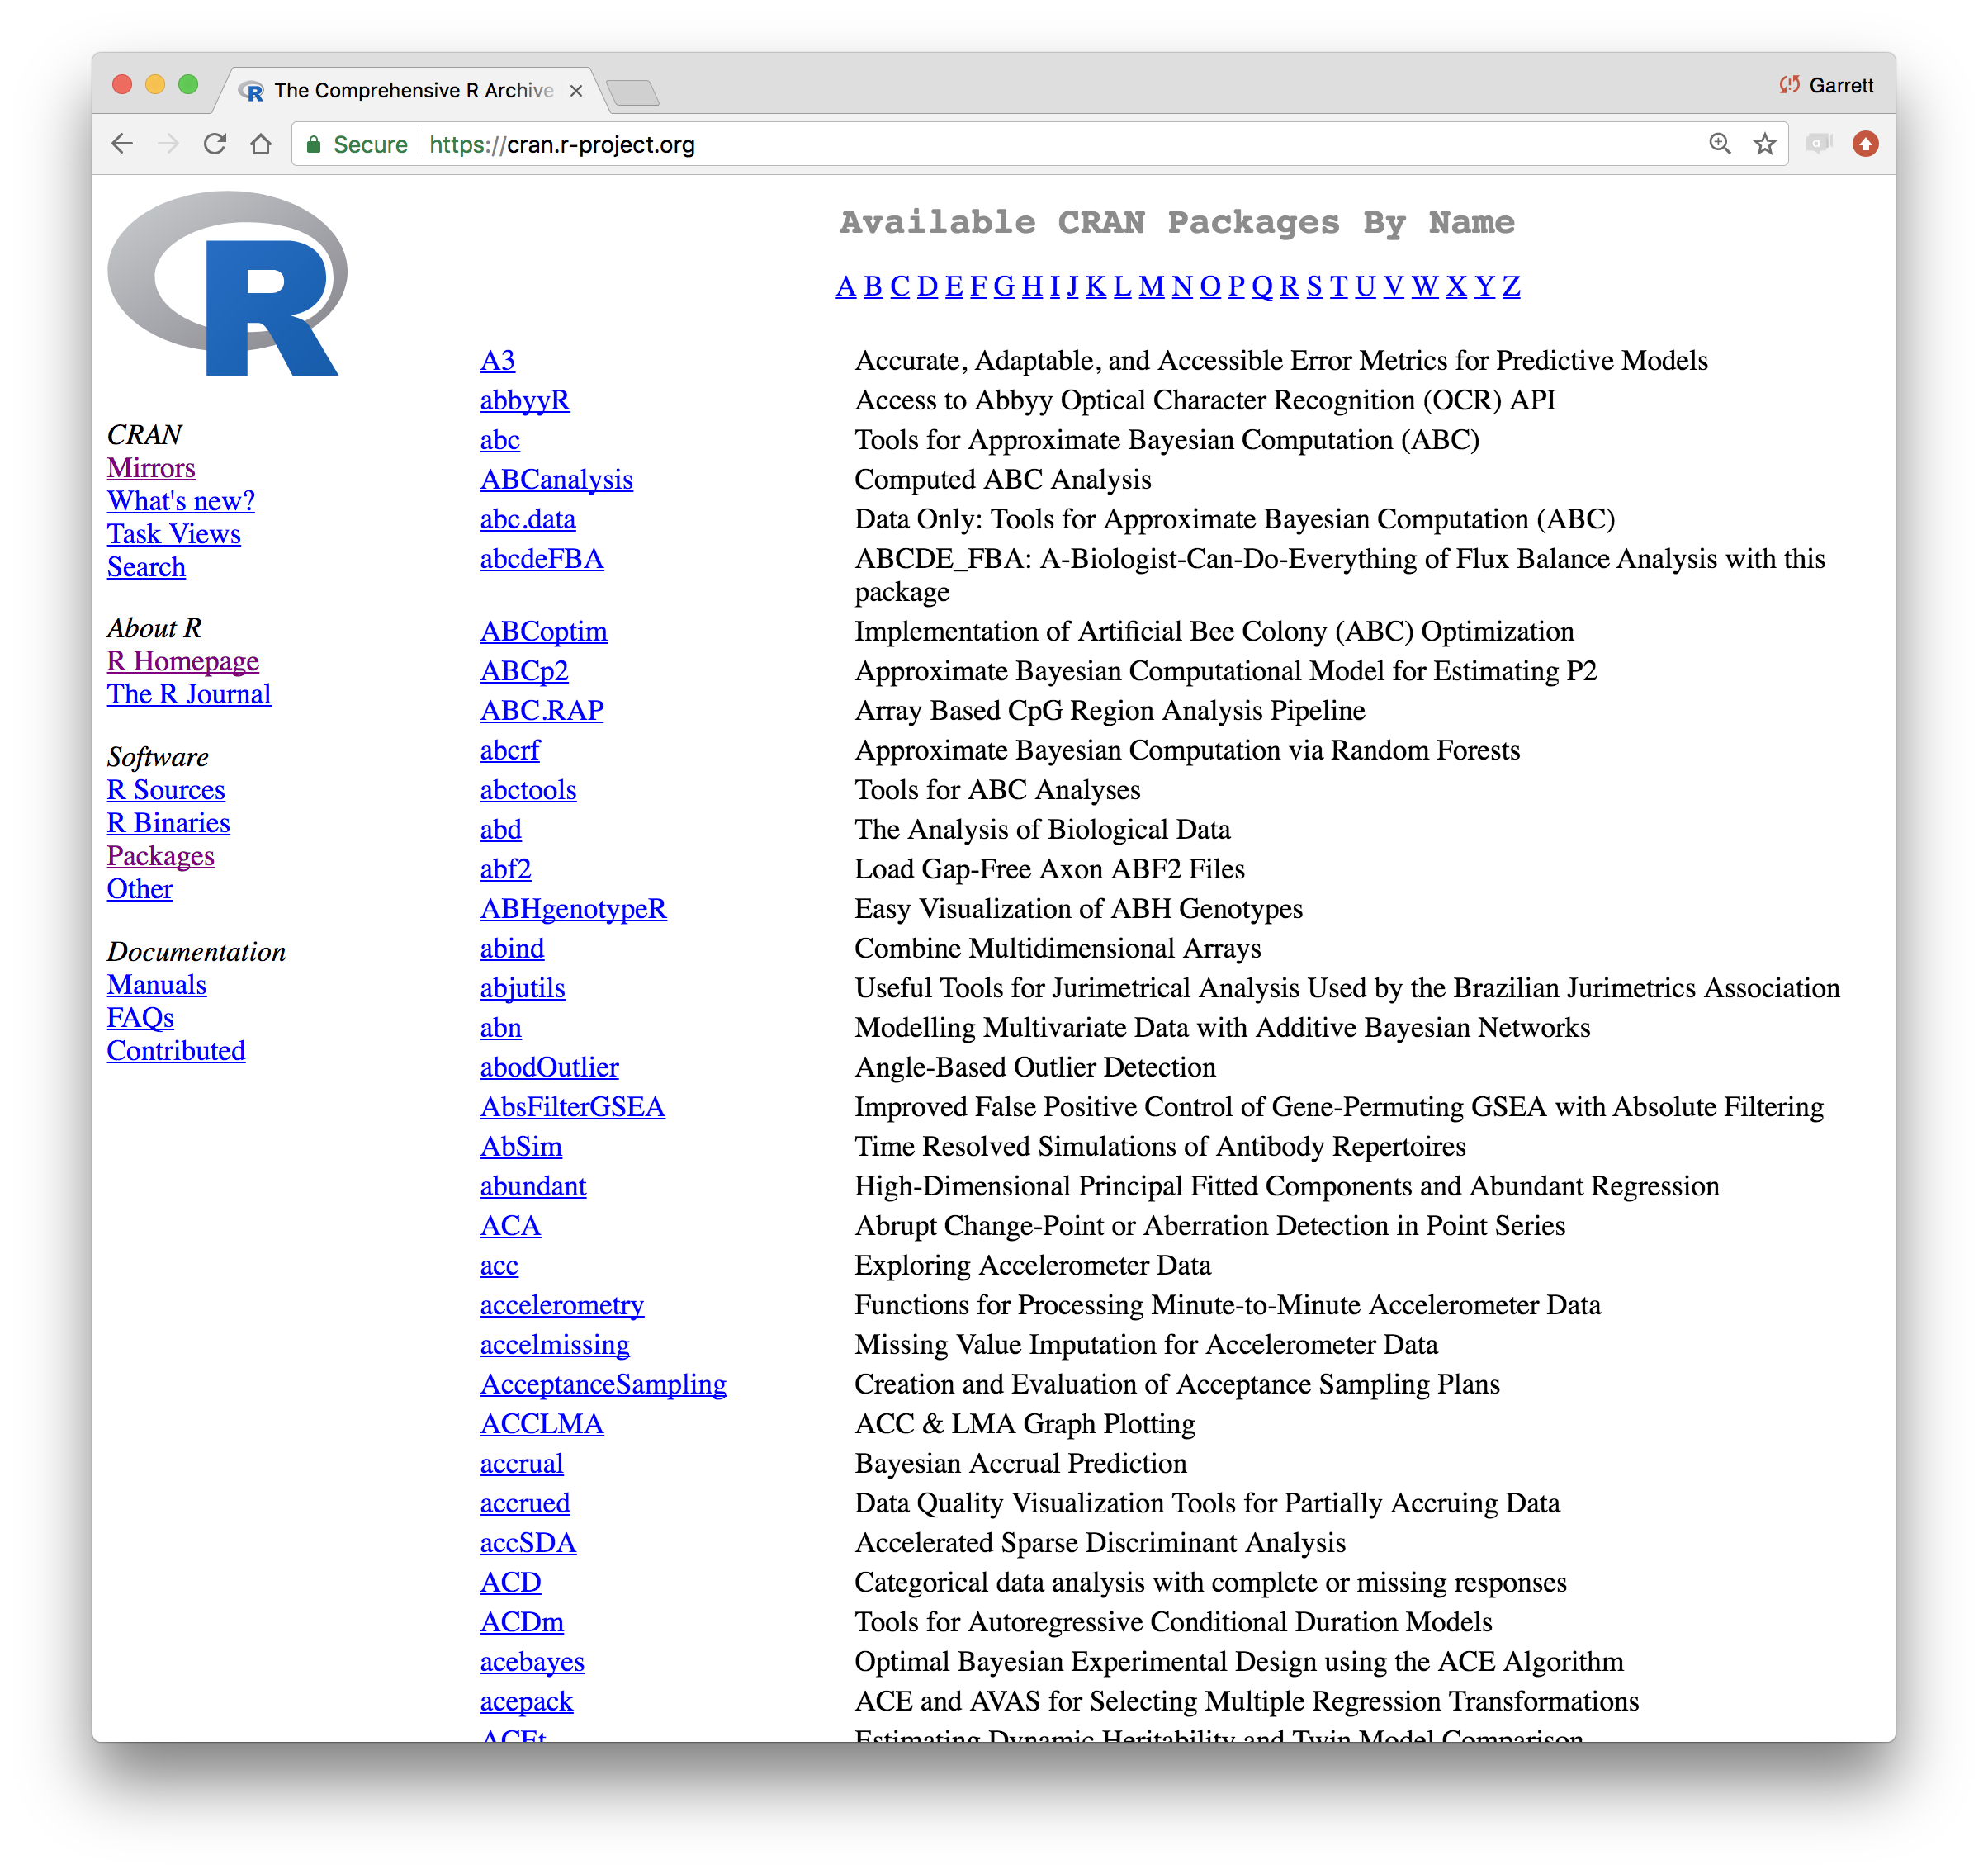
Notes:
Most R packages are stored on CRAN, alongside R. Think of them as optional extensions of the R language.
This organization is great for R in two ways. First, it makes R fast. When you call a function name, R only needs to search through the packages that you have installed and loaded. If R had to search through every function that existed, it would take a long time. (Not to mention that it would take a long time to download all of those functions). Second, it makes it very easy to extend R. If you'd like to add new functions for R users to use, all you need to do is write a package. As of yesterday, there were 12,000 R packages.

Slide 32
14108
packages
in 5/2019
18998
packages
in 3/2022
Graph by https://besteamperu.org
Notes:
Most R packages are stored on CRAN, alongside R. Think of them as optional extensions of the R language.
This organization is great for R in two ways. First, it makes R fast. When you call a function name, R only needs to search through the packages that you have installed and loaded. If R had to search through every function that existed, it would take a long time. (Not to mention that it would take a long time to download all of those functions). Second, it makes it very easy to extend R. If you'd like to add new functions for R users to use, all you need to do is write a package. As of this month, there were nearly 19,000 R packages on CRAN. Some packages – especially new ones under development – also live elsewhere.

Slide 33
Using packages
1
install.packages("foo")
Downloads files to computer
1 x per computer
33
Notes:
Before you can use a package, you need to ask R to install the package on your computer. You can do this by opening R and then typing the command: install.packages at the command line. after install.packages, place a pair of parentheses that contain the package name surrounded by quotation marks. R will download the package and install it on your computer. You only need to do this once per package (because after you install it, the package is on your computer. There is no reason to re-download it unless a new version is available).
However, downloading a package isn't the same as using it. If you'd like to use an R package, you need to tell R. You do that by running the command library, again followed by parentheses and the package name. library loads all of the functions, data sets and help pages that come with the package into your R session, where you can use them. If you close R, you'll need to reload the package with library() if you want to use it again.

Slide 34
Using packages
1
2
install.packages("foo")
library("foo")
Downloads files to computer
Loads package
1 x per computer
1 x per R Session
34
Notes:
Before you can use a package, you need to ask R to install the package on your computer. You can do this by opening R and then typing the command: install.packages at the command line. after install.packages, place a pair of parentheses that contain the package name surrounded by quotation marks. R will download the package and install it on your computer. You only need to do this once per package (because after you install it, the package is on your computer. There is no reason to re-download it unless a new version is available).
However, downloading a package isn't the same as using it. If you'd like to use an R package, you need to tell R. You do that by running the command library, again followed by parentheses and the package name. library loads all of the functions, data sets and help pages that come with the package into your R session, where you can use them. If you close R, you'll need to reload the package with library() if you want to use it again.

Slide 35
Alternatively, get 2 in 1:
1
2
install.packages("foo")
library("foo")
Downloads files to computer
Loads package
1 x per computer
1 x per R Session
pacman::p_load(foo)
35
Notes:
Before you can use a package, you need to ask R to install the package on your computer. You can do this by opening R and then typing the command: install.packages at the command line. after install.packages, place a pair of parentheses that contain the package name surrounded by quotation marks. R will download the package and install it on your computer. You only need to do this once per package (because after you install it, the package is on your computer. There is no reason to re-download it unless a new version is available).
However, downloading a package isn't the same as using it. If you'd like to use an R package, you need to tell R. You do that by running the command library, again followed by parentheses and the package name. library loads all of the functions, data sets and help pages that come with the package into your R session, where you can use them. If you close R, you'll need to reload the package with library() if you want to use it again.

Slide 36

The Tidyverse
Collection of modern R packages that share common philosophies, embed best practices, and are designed to work together.
A dialect of R
Our choice for today!
Notes:
A collection of R packages that are designed to work well together. All of the packages share a common philosophy about how functions should work with each other. And all of the packages are written to support an overarching vision of data science best practices. This network diagram arranges tidyverse packages by their common contributors, which identifies another source of continuity between the packages: they are developed by a coherent group of developers, many of whom are professional R developers who create and maintain the packages as their full time job (not always common with an open source language like R).

Slide 37
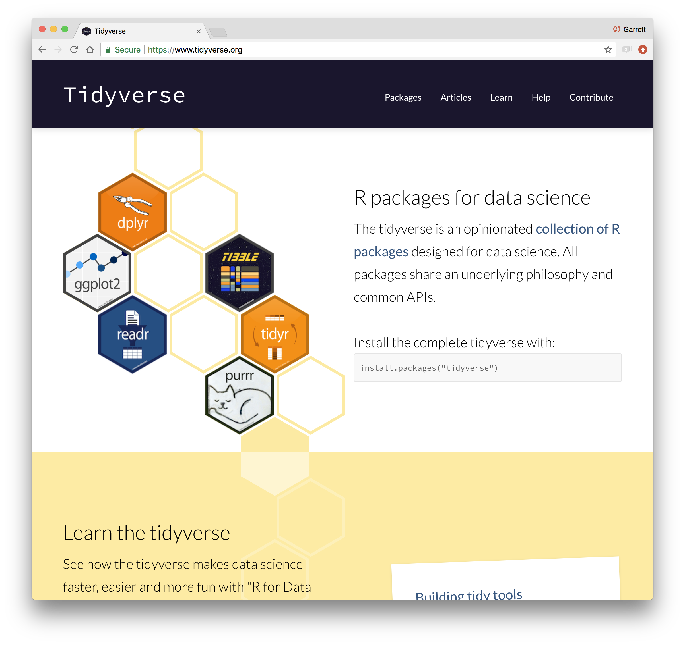
tidyverse.org
Notes:
Perhaps because of this, the tidyverse functions are extremely well documented and easy to learn. And since they are designed to work in similar ways, learning one function teaches you a lot about using the rest.

Slide 38
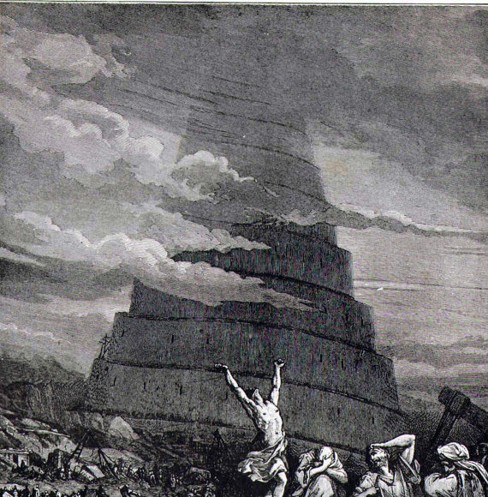
38
Notes:
In short, R has a Tower of Babel problem. Different users like to do different things in different ways. If we cover something that you already know how to do in a different way, you don't need to change. In most cases, I think the tidyverse methods will provide a slight advantage (but the key word here is slight, and the advantage is often in the ease of learning it). If you already know how to do something well, there's no need to retrain yourself. That said, take a look at what I'm teaching and see what you think.

Slide 39
tidyverse
An R package that serves as a short cut for installing and loading the components of the tidyverse.
install.packages("tidyverse")
39
Notes:
One example of how tidyverse packages are tightly integrated with each other is that there is a package named tidyverse, that installs them all with one command.

Slide 40
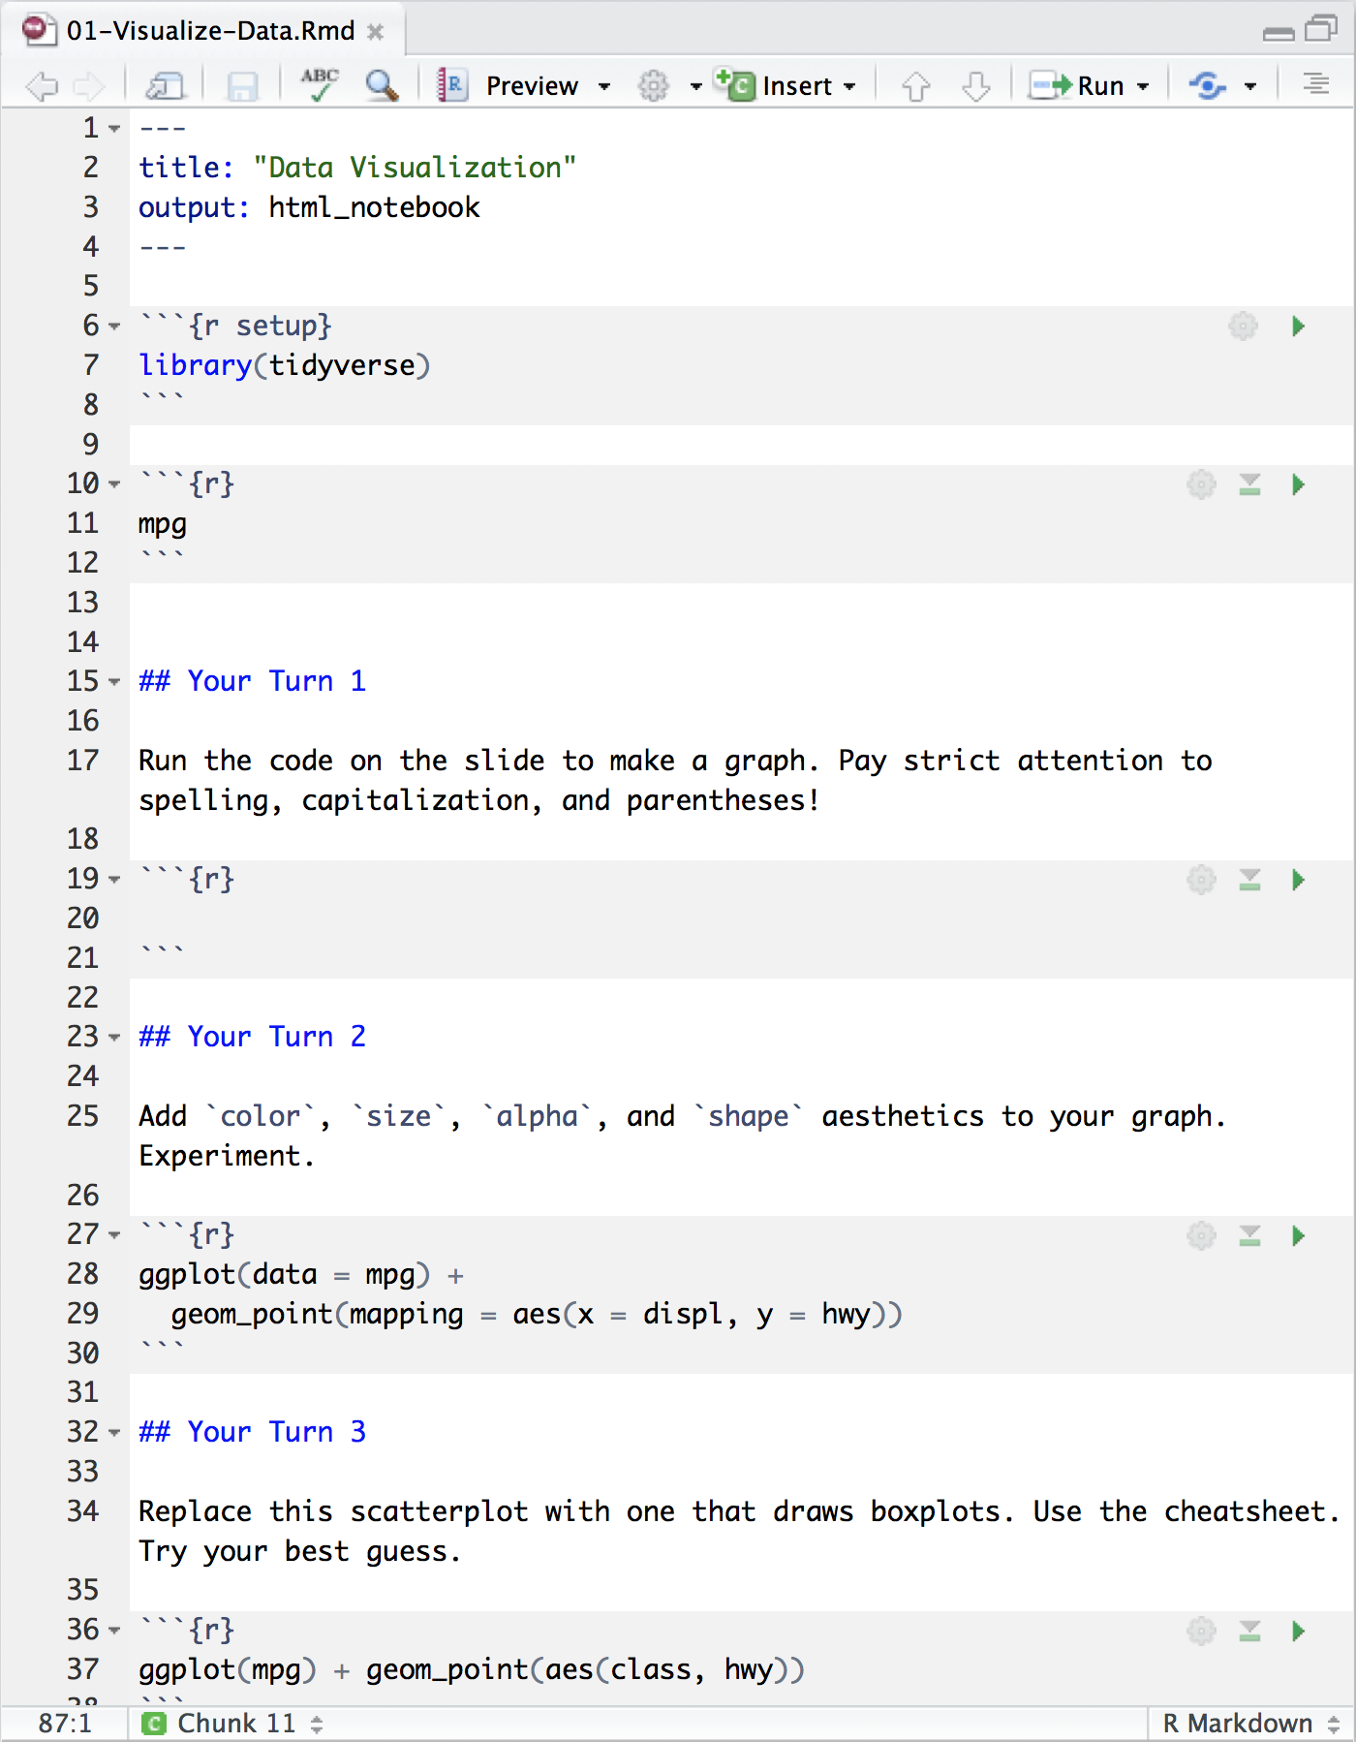
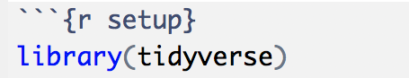
Setup
The setup chunk is always run once before anything else
Chunk labels are optional, the setup label is special

Slide 41
Your Turn
Navigate up to the 02-Visualize folder.
Open 02-Visualize-Exercises.Rmd
Add a setup chunk that loads the tidyverse packages.
02:00

